Slide 1
Enforcing Right to Explanation: Understanding the Trade-offs with Privacy & Unlearning
Hima Lakkaraju

Slide 2
Motivation: Right to Explanation
[ Goodman and Flaxman, 2016 ]
GDPR, Article 22, Recital 71: “A subject has the right to an explanation of the decision reached after algorithmic assessment”

Slide 3
Motivation: Right to Explanation
Blueprint for an AI Bill of Rights (OSTP) -- Notice and Explanation: “You should know how and why an outcome impacting you was determined by an automated system”

Slide 4
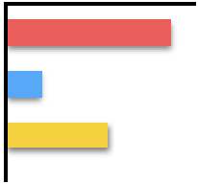
Operationalizing RTE
[ Larson et. al. 2016 ]
This prediction is biased. Race and gender are being used to make the prediction!!
Defendant Details
Model Understanding
Race
Crimes
Gender
Predictive
Model
Prediction = Risky to Release

Slide 5
Operationalizing RTE
I have some means for recourse. Let me go and work on my promotion and pay my bills on time.
Loan Applicant Details
Model Understanding
Increase salary by 5K + pay credit card bills on time for next 3 months to get a loan
Predictive
Model
Prediction = Denied Loan
Loan Applicant

Slide 6
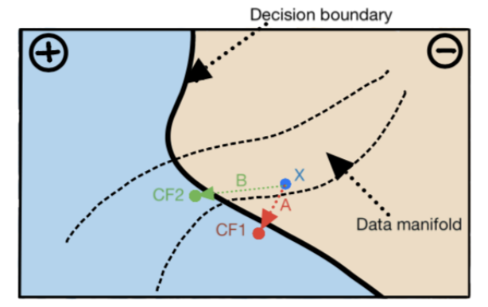
Generating Algorithmic Recourse: Intuition
Proposed solutions differ on:
How to choose among
candidate counterfactuals?
How much access is needed to
the underlying predictive model?

Slide 7
Generating Algorithmic Recourse
[ Verma et. al. 2020; Wachter et. al. 2017; Ustun et. al. 2018; Karimi et. al. 2020; Rawal & Lakkaraju, 2020]
Minimum distance counterfactuals (CFE): Find a counterfactual (that flips the prediction) that is closest to the original instance
Feasible counterfactuals (AR): Find low-cost counterfactuals that are feasible (e.g., changes to race are not allowed)
Causally feasible counterfactuals (MINT): Find minimum distance counterfactuals that are feasible as per structural causal models

Slide 8
Challenges with Recourse Algorithms

Slide 9
Challenges with Recourse Algorithms

Slide 10
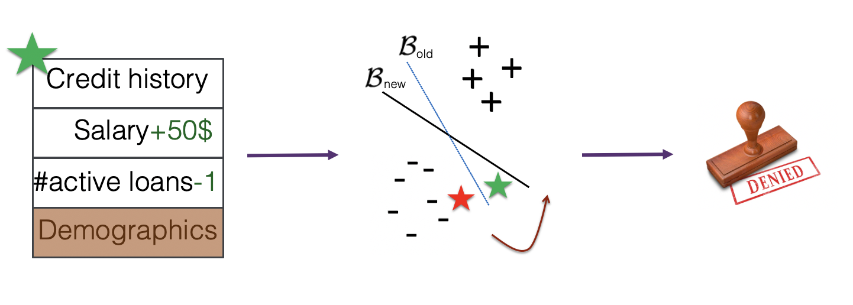
Challenges with Recourse Algorithms

Slide 11
Challenges with Recourse Algorithms
Some causes of model shifts:
Dataset shifts -- e.g., temporal shifts
Data deletion requests

Slide 12
Addressing the Challenges with Recourse Algorithms
Upadhyay et. al., NeurIPS 2021

Slide 13
Addressing the Challenges with Recourse Algorithms

Slide 14
Addressing the Challenges with Recourse Algorithms

Slide 15
RObust Actionable Recourse (ROAR)

Slide 16
RObust Actionable Recourse (ROAR)

Slide 17
ROAR: Theoretical Results
Theorem 1: Lower bound on the probability of recourse invalidation for existing methods
Theorem 2: Upper bound on the additional costs incurred by recourses output by our framework ROAR

Slide 18
Experimental Results
Datasets capturing correction shift (German credit data), temporal shift (loan approval data), geospatial shift (student performance).
Metrics: Avg. cost of recourse, validity of recourse with models 1 (original data) and 2 (shifted data)
Recourses generated by our framework ROAR are valid even when the underlying model is updated!

Slide 19
Explanations Robust to Model Changes due to Data Deletion
Krishna and Ma, ICML 2023

Slide 20
Explanations Robust to Model Changes due to Data Deletion
Krishna and Ma, ICML 2023
Let us say k << N is the max. number of deletion requests
Naïve solution:
Consider N choose k possible models

Slide 21
Explanations Robust to Model Changes due to Data Deletion
Krishna and Ma, ICML 2023
Naïve solution is computationally prohibitive
Our solution:
N choose k models can be viewed as leave-k-out (LKO) estimators
Efficiently approximate these via first-order Taylor approximations w.r.t. initial model
Further reduce the model set by only choosing models with most significant deviations from the initial model
Theoretical guarantees on validity and additional costs incurred in case of linear models and non-linear models with bounded curvature

Slide 22
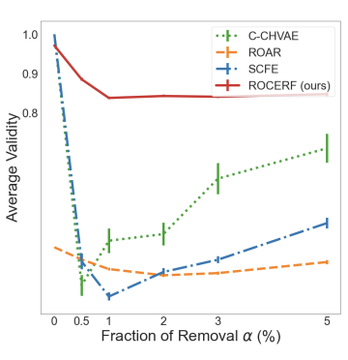
Explanations Robust to Model Changes due to Data Deletion
Krishna and Ma, ICML 2023
Validity and cost results with neural networks

Slide 23
Trade-offs between Explainability and Privacy
Right to Explanation vs. Right to Privacy
Model explanations enable adversaries to infer which individuals were present in the training data of the model.
[Pawelczyk et. al., AISTATS 2023]
Notes:
Explain how a point becomes invalid when the decision boundary smoothens, and
then talk about the two things we plan to analyse in the paper.
Animation : Points -> Adversarial Boundary -> Invalidation -> Cost.

Slide 24
In the Era of LLMs..

Slide 25
Explainability in LLMs
Good News: LLMs seem to be able to explain their outputs!
Q: Below are the details of a patient ..
………..
………..
Based on these details, do you think this patient is likely to be diagnosed with epilepsy within the next year?
GPT 3.5: Yes.
Q: Please list the top 3 factors from the patient profile that are driving your recommendation.
GPT 3.5: ESR, WBC, Serotonin are the top 3 factors driving my recommendation.
GPT 3.5 fine-tuned with historical patient data; Accuracy: 83.48%
Hamilton et. al. (in preparation), “On the Illusion of Explainability in LLMs and Its Implications”

Slide 26
Understanding the Impact of LLM Explanations
Early detection of epilepsy
Is a given patient likely to be diagnosed with epilepsy within the next year?
All doctors have access to patient profiles
We conducted a user study with 97 doctors (residents, internal medicine)
Control: Doctor makes the decision on their own
Treatment Group 1: Doctor + Recommendation from GPT
Treatment Group 2: Doctor + Recommendation + Explanation from GPT

Slide 27
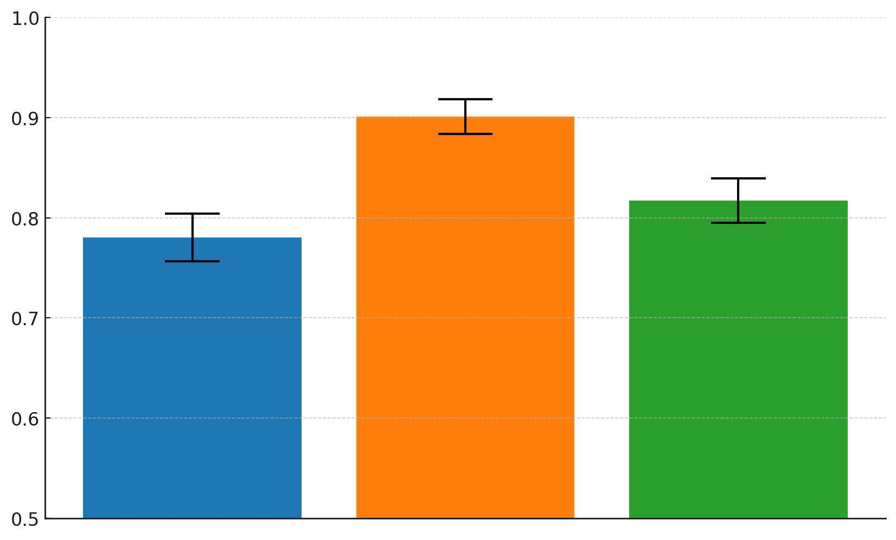
Understanding the Impact of LLM Explanations
90.08%
81.71%
78.02%
Decision-Making Accuracy
Doctor
Only
Doctor +
GPT Recommendation
Doctor +
GPT Recommendation +
Explanation
27
GPT 3.5 fine-tuned with historical patient data; Model Accuracy: 83.48%

Slide 28
On the Illusion of Explainability in LLMs
Perturbation tests that capture how the model’s confidence in its recommendation changes with unit change in each of the input features.
Perturbation tests reveal different insights than self-explanations of LLMs.
In 68.37% of the instances, none of the top 3 features match!
Explanations output by LLMs may not be capturing the behavior of the underlying models reliably, but human experts seem to be readily trusting these models due to their conversational nature & confirmation biases!

Slide 29
Conclusions and Summary
Several challenges to enforcing right to explanation in practice
Trade-offs between explainability and other notions of trustworthiness such as privacy, unlearning, and robustness to data distribution shifts.
In LLMs: Currently, explanations seem to be plausible but not faithful!
Unclear if and how the above trade-offs manifest in LLMs.

Slide 30
Thank You!
Email: hlakkaraju@hbs.edu; hlakkaraju@seas.harvard.edu;
A semester-long course on interpretability and explainability: https://interpretable-ml-class.github.io/
A day-long course on interpretability and explainability on Stanford’s Youtube Channel
More tutorials on interpretability and explainability: https://explainml-tutorial.github.io/
Trustworthy ML Initiative: https://www.trustworthyml.org/
Lots of resources and seminar series on topics related to explainability, fairness, adversarial robustness, differential privacy, causality etc.

